Slide 1
Machine Learning: Specialization in Deep Learning
Presented by – Swati Kanchan & Lokesh Nandanwar

Slide 2
Overview
ML Basics
Why Machine Learning?
Learning categories
Classification
Clustering
Regression
Neural Network
What is Neural Network?
Analogy with brain
Why Deep Learning?
Logistic Regression as Neural Network
Logistic Regression
Binary Classification
Cost Function
Gradient Descent
Derivative

Slide 3
….Overview contined
Shallow Neural Network
Computing NN outputs
Activation Function and Derivatives
Example with Keras gradient descent
Deep Neural Network
Deep L-layer NN
Building blocks
Forward and Backward propagation
Parameter vs Hyperparameters
Example with Keras
Housing-Price problem with NN
An overview of Cat-Dog Classification

Slide 4
Machine Learning Basics

Slide 5
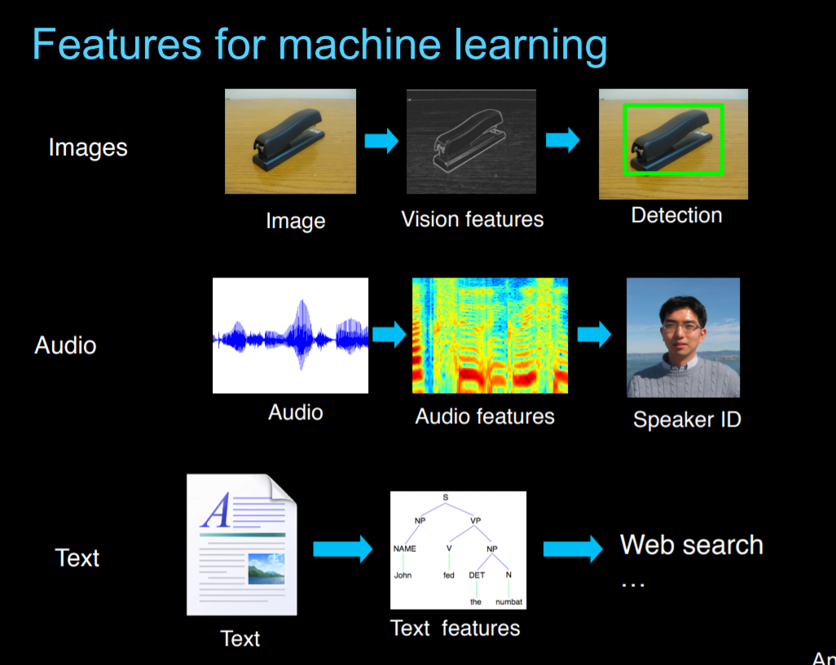
Why Machine Learning?

Slide 6
Learning categories
Supervised Learning: the correct classes of the training data are known
Unsupervised Learning: the correct classes of the training data are not known
Semi-Supervised Learning: A Mix of Supervised and Unsupervised learning
Reinforcement Learning: Allows the machine or software agent to learn its behavior based on feedback from the environment. This behavior can be learnt once and for all, or keep on adapting as time goes by.

Slide 7
Machine Learning Techniques

Slide 8
Classification
Predict class from observations
Classify a document into a predefined category.
Documents can be text, images
Example with images: a cat-dog classifier

Slide 9
Clustering
group observations into “meaningful” groups
clustering is the task of grouping a set of objects in such a way that objects in the same group (called a cluster) are more similar to each other.
For e.g. these keywords
– “man’s shoe”
– “women’s shoe”
– “women’s t-shirt”
– “man’s t-shirt”
– can be cluster into 2 categories “shoe” and “t-shirt” or
“man” and “women”
Popular ones are K-means clustering and Hierarchical clustering

Slide 10
Regression
predict value from observations
is a measure of the relation between the mean value of one variable (e.g. output) and corresponding values of other variables (e.g. time and cost).
regression analysis is a statistical process for estimating the relationships among variables.
Regression means to predict the output value using training data.
Popular one is Logistic regression (binary regression)

Slide 11
Neural Networks

Slide 12
What is Neural Network?
It is a powerful learning algorithm inspired by how the brain works.
The idea:
Build learning algorithms that mimic the brain.
Most of human intelligence may be due to one learning algorithm.

Slide 13
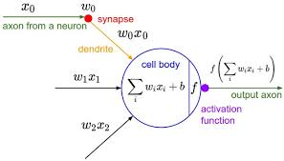
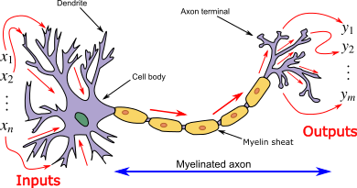
Analogy with Brain:

Slide 14
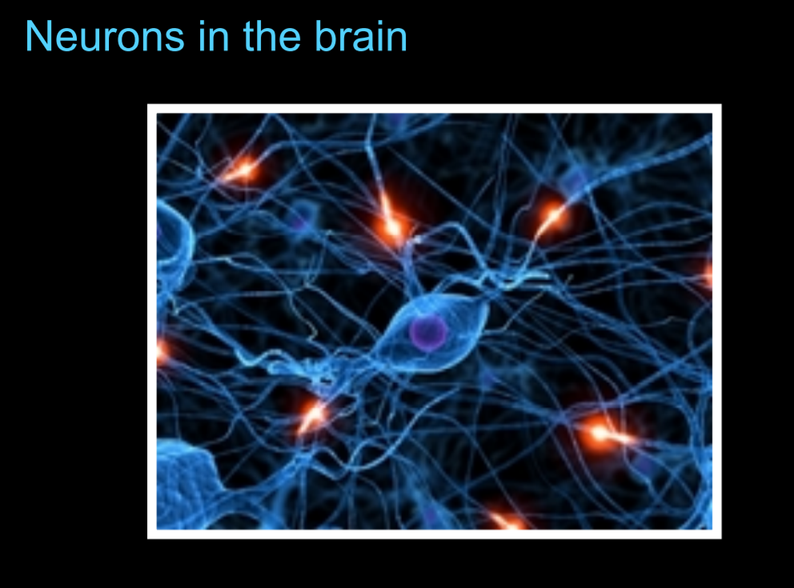
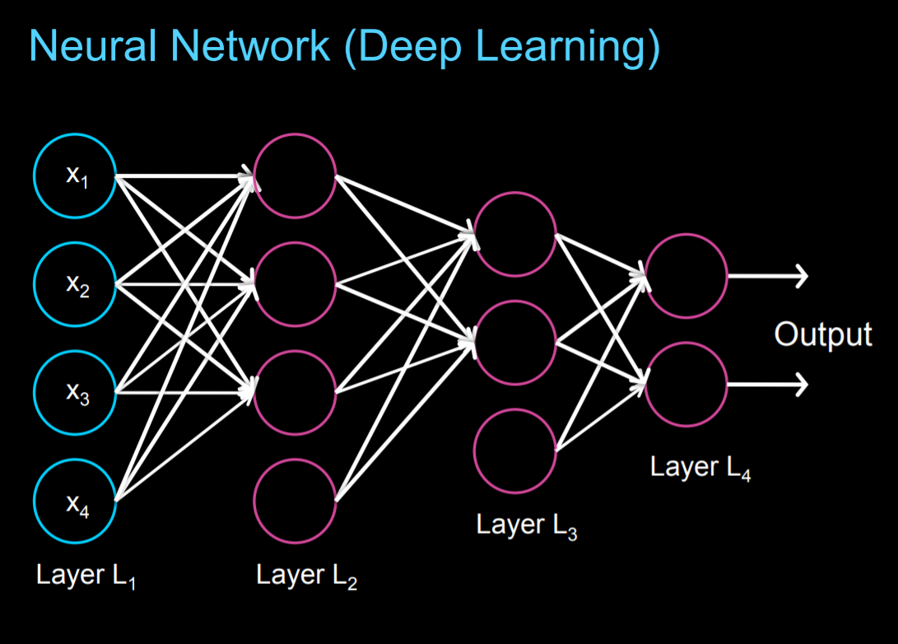

Slide 15
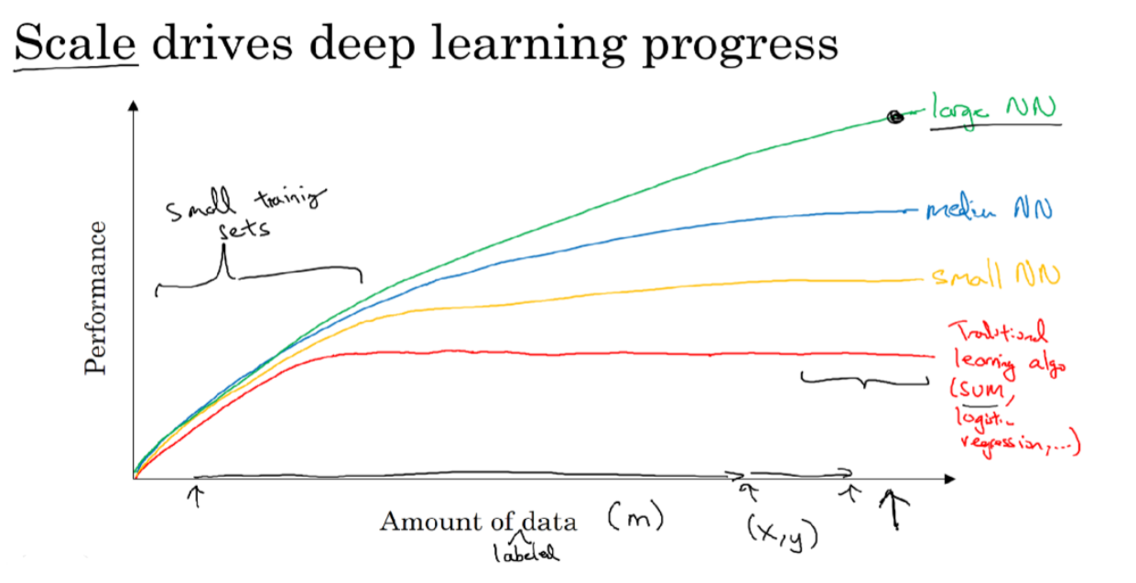
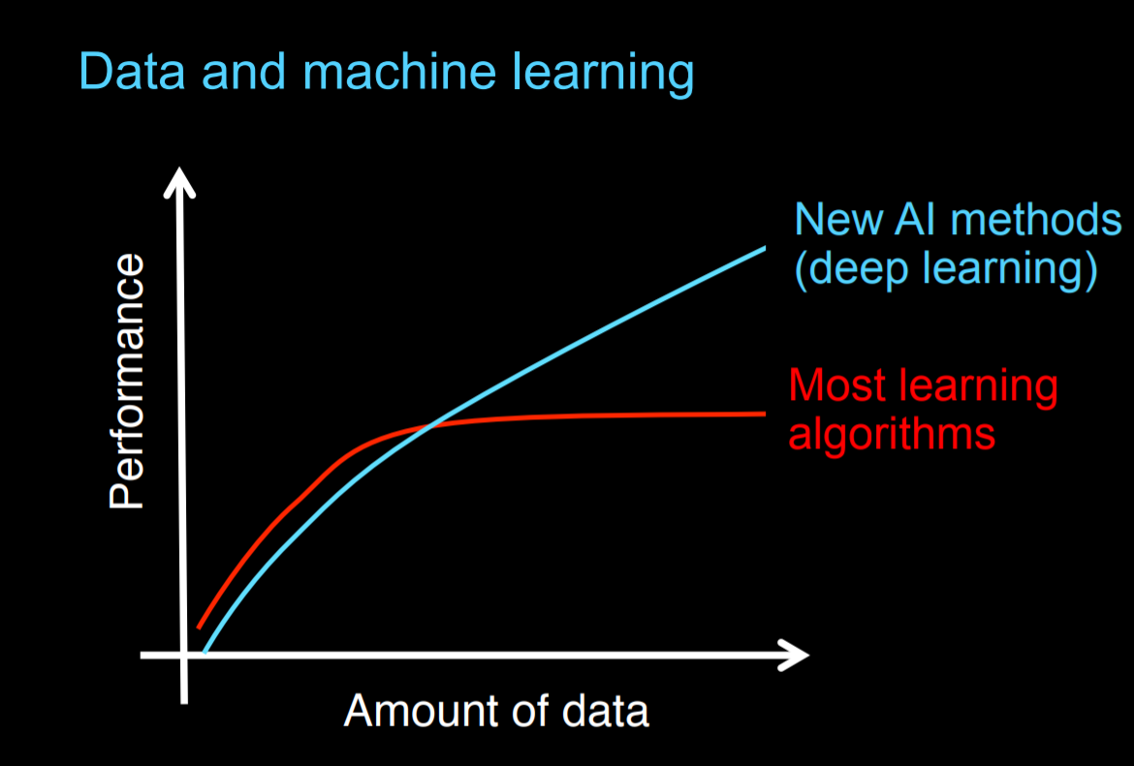
Why Deep Learning?

Slide 16
Why Deep Learning?....continued
Deep learning is taking off due to a large amount of data available through the digitization of the society, faster computation and innovation in the development of neural network algorithm.
Two things have to be considered to get to the high level of performance:
1. Being able to train a big enough neural network (GPUs come to rescue!)
2. Huge amount of labeled data
The process of training a neural network is iterative.
Idea -> Experiment -> Code

Slide 17

Why need GPUs?
It could take a good amount of time to train a neural network, which affects your productivity. Faster computation helps to iterate and improve new algorithm. This can only be achieved by using GPUs.

Slide 18
Logistic Regression…to be continued

